Slide 1

Bug Zapper
ESE441: Thomas Suarez, Ricky Zhang, Frank Yee
Project Proposal:Prof. David Westerfeld
Spring 2017

Slide 2

Presentation Outline
Project Goal
Background
Design and Constraints
Final Design
Implementation and testing
Closing Remarks

Slide 3



Project Goals
The goal of this project is to create a mosquito zapping device that activates by detecting the sound created by the flight tone of mosquitoes.
A microphone, with DSP (Digital Signal Processing), and zapper will detect and eliminate the target.

Slide 4
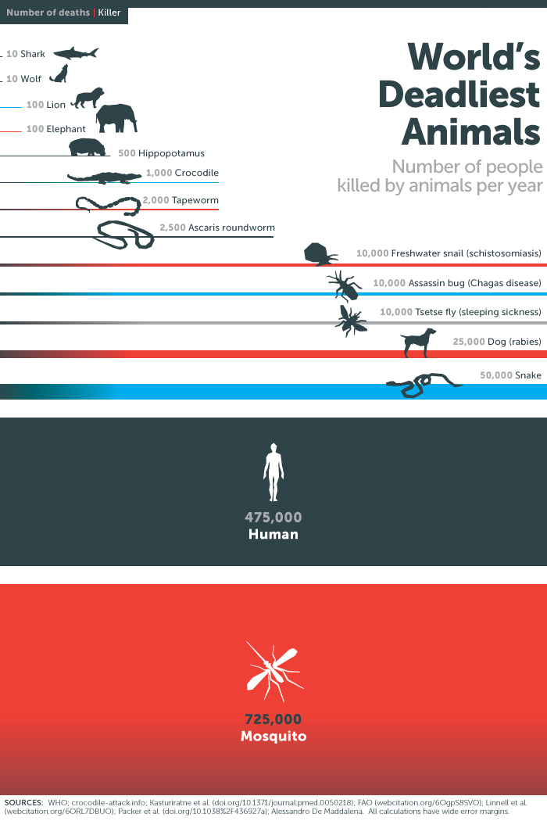
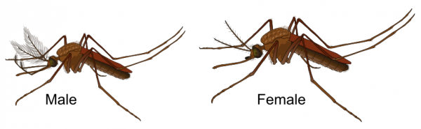
Background
The Deadliest Animal in the World: Mosquitoes [1]
Current Zappers are ineffective in eliminating biting insects, the problem lies in the inability to differentiate between insects in general and mosquitos.
Female mosquitoes ranged from 421 to 578 Hz [2]
Bug Zapper - Prevention not a cure
[1]https://www.gatesnotes.com/Health/Most-Lethal-Animal-Mosquito-Week
[2]https://www.ncbi.nlm.nih.gov/pmc/articles/PMC3985972/

Slide 5
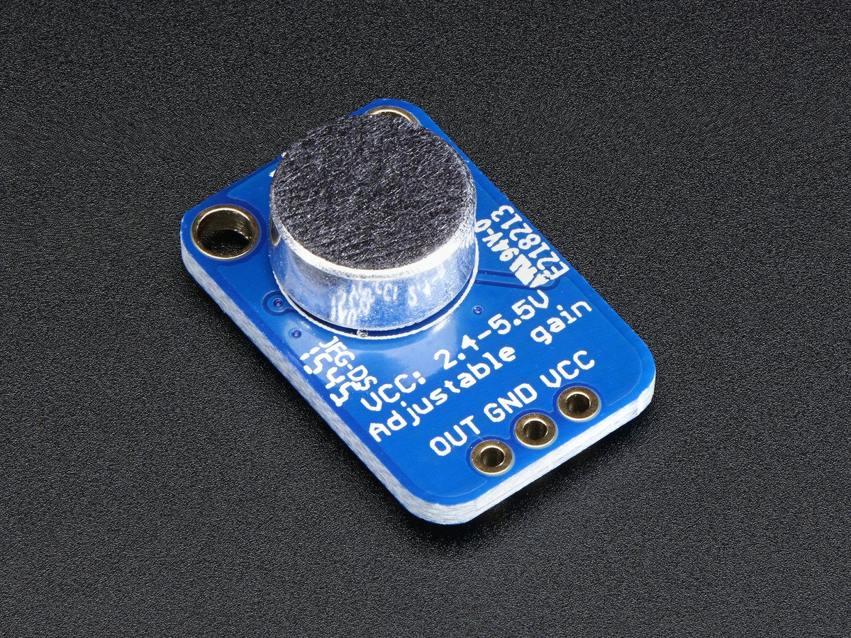
Design: Microphone
Microphone sensitive enough to read small amplitude signals and high enough quality not to create too much noise.
Electret condenser microphone from CUI Inc.
Operating voltage 3 V dc (standard) to 10 V dc (max.)
20Hz ~ 20kHz
Omnidirectional
Sensitivity (S) -44 ±2 dB
Maxim MAX4466 -
+2.4V to +5.5V Supply Voltage Operation
Microphone Preamplifier
“excellent choice for noisy environments because of their high common mode rejection(126dB) and excellent power-supply rejection ratios(112dB)” [3]
[3]https://datasheets.maximintegrated.com/en/ds/MAX4465-MAX4469.pdf

Slide 6
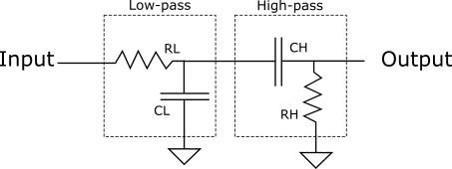
Design: Filtering
Currently using a first order bandpass filter with a passband: 400Hz to 1000Hz. Recalling the microphone has frequency range: 20Hz ~ 20kHz, and female mosquitoes ranged from 421 to 578 Hz.
Insertion loss - (power loss, or loss within passband) tells us how much smaller the signal is after being processed by the passive filter.
Roll Off - The rate (in dB/decade) that the power in a signal is attenuated outside of the passband as a function of frequency.
Consider higher order filters (active second order filter)
Is a Low-pass filter actually required?
Consider Nyquist frequency and how the code functions
Considerations and Constraints

Slide 7
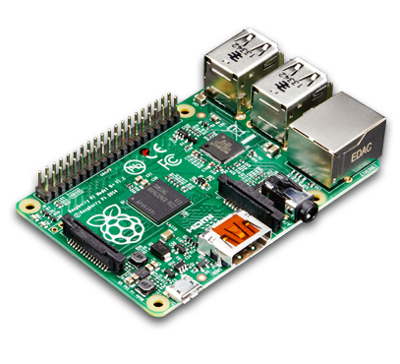
Design: Audio data into Raspberry Pi
Audio goes through the input of the microphone and an analog signal comes out as the output.
Detected sounds will then be sampled as a continuous signal into the input of ADS1015 , a 12-bit Analog-to-digital Converter (ADC).
The ADC will communicate with Raspberry pi through I2C (Inter-Integrated Circuit).
RPI- uses Python, and helps with visualization of data being collected and processed.

Slide 8
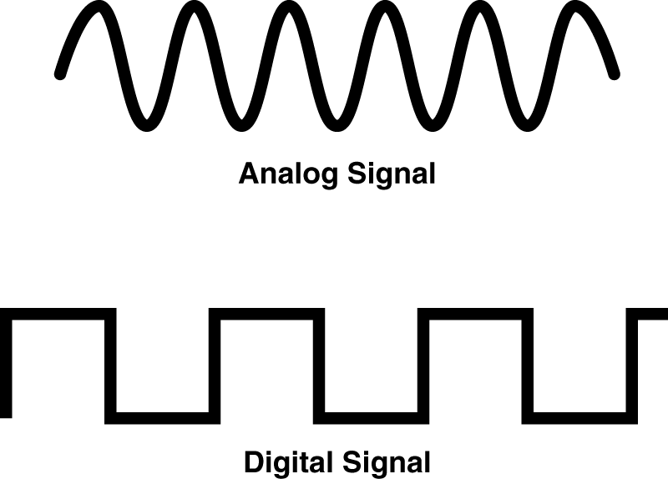
Design: Digital Signal Processing
Used Python to analyze and process the data from the ADC. The program will ask the user for a sampling rate and runtime to determine the length of the dataset.
Data will be logged into an array which will have a Fast Fourier Transform (FFT) convert the array from the time domain to the frequency domain. The input signal will be analyzed and the specific frequencies of mosquitoes will trigger the zapper.

Slide 9
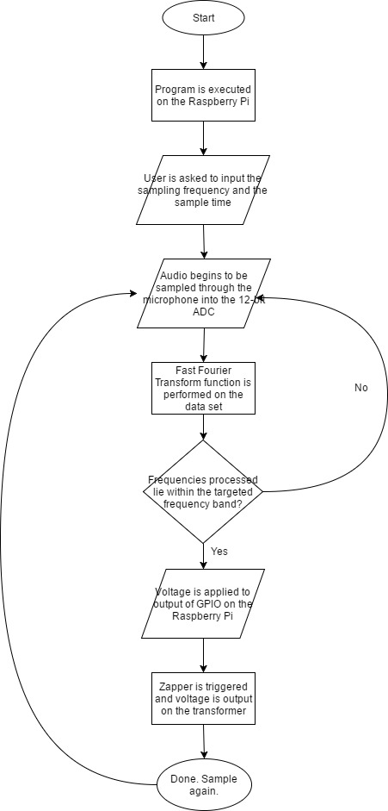
Flow Chart
The program will prompt the user to input a sampling frequency and sample time.
The program will run continuously with the given parameters.
The data output from the ADC will be processed with a FFT function and if targeted frequencies are discovered, the zapper will be triggered.

Slide 10
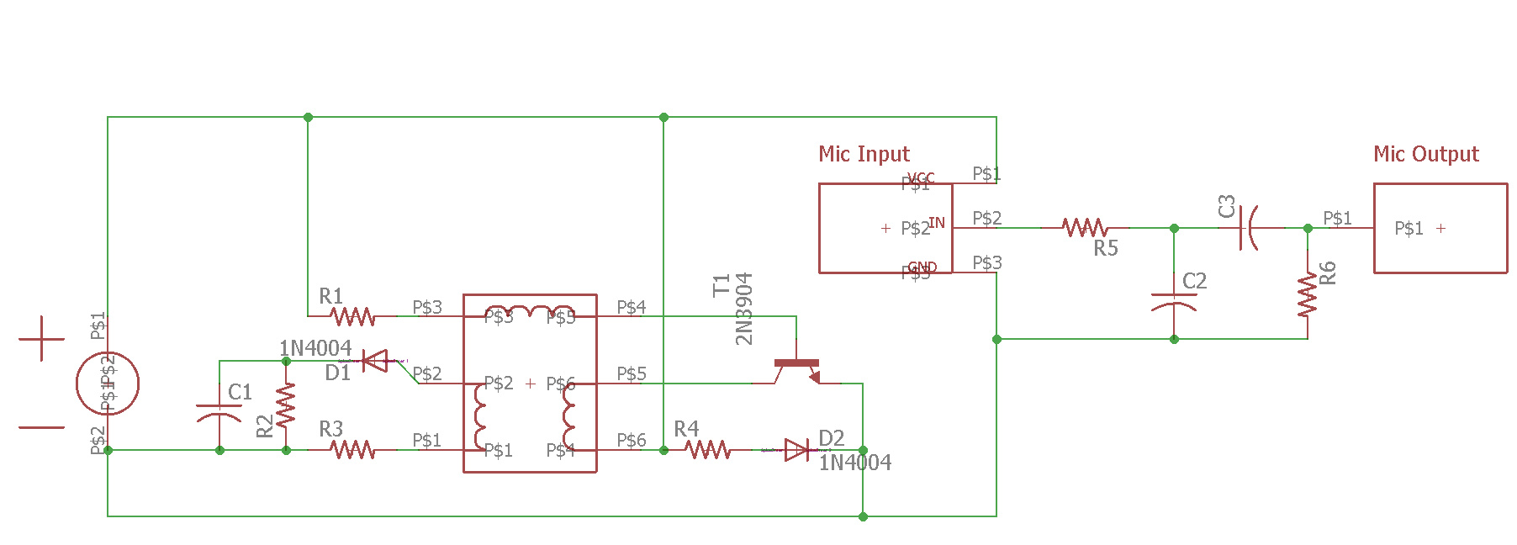
Final Design: Schematic
The zapping part of the device uses a center tapped transformer with a npn transistor. The center tapped primary coils with the transistor to provide an oscillating voltage. The secondary coil provide the step up for the high voltage.
Consider voltage multiplier for increased voltage.

Slide 11
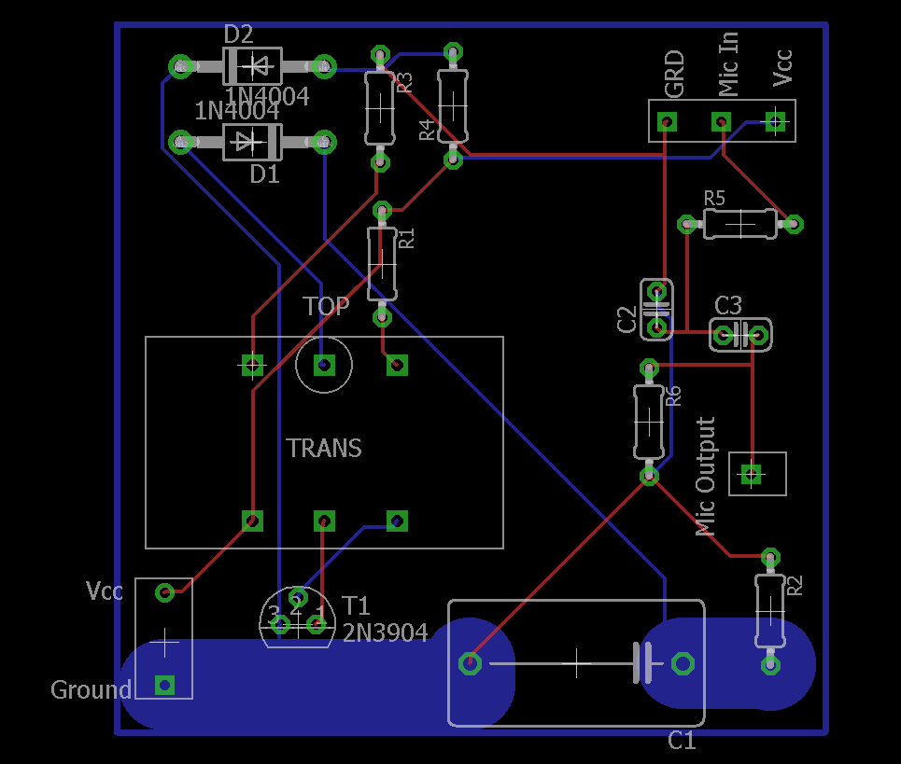
Final Design: Boardview
A 2-layer(double-sided) pcb will be used to create the circuits. PCB layout created using eagle cad tool.
Traces connecting all components with thick traces for the capacitor in case of high current.

Slide 12
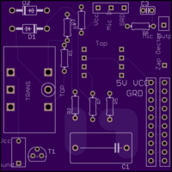
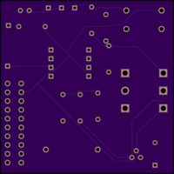
Final Design: Printed Circuit Board
OSH Park
50mm x 50mm PCB
Design Rule and Clearances checks before being sent for fabrication
PCB Substrate dielectric constant of 4.6 at 1MHz. (4.6 > typical values for FR-4 material)
Front View
Back View

Slide 13
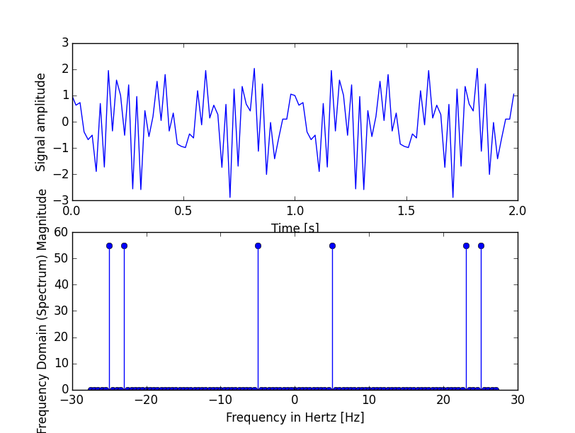
Hardcoded a signal that is to be processed:
x1= np.sin(23* 2* np.pi * t)
x2= np.cos(5* 2* np.pi * t)
x3= np.sin(25* 2* np.pi * t)
Frequencies (Orange) are detected
Implementation and Testing: Step 1

Slide 14
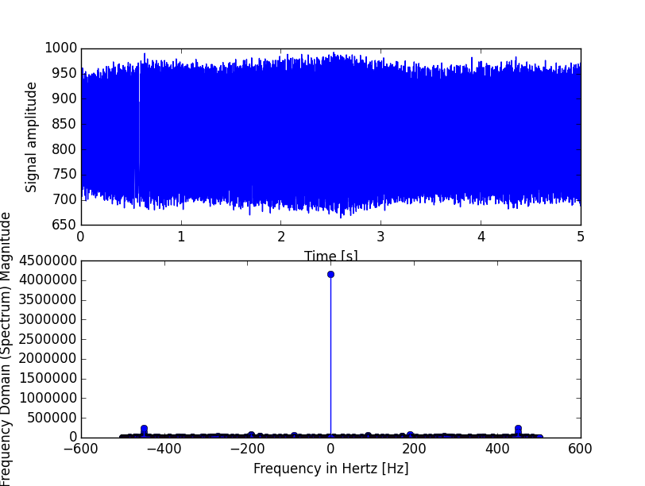
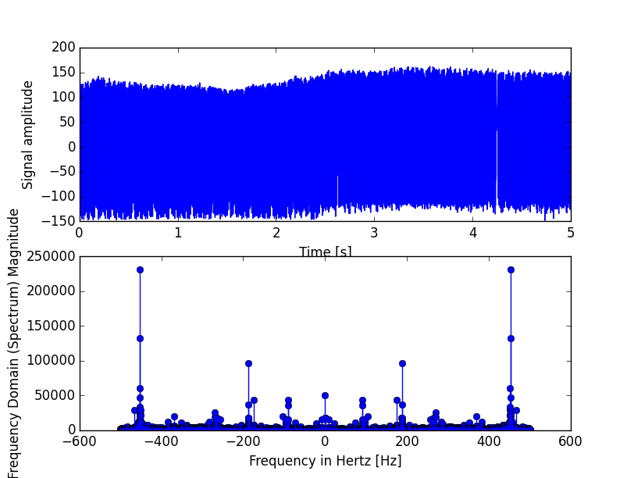
No Filter
First order (temp) Filter
Real Signal using Tone generator: 450hz at 1k samples per sec

Slide 15
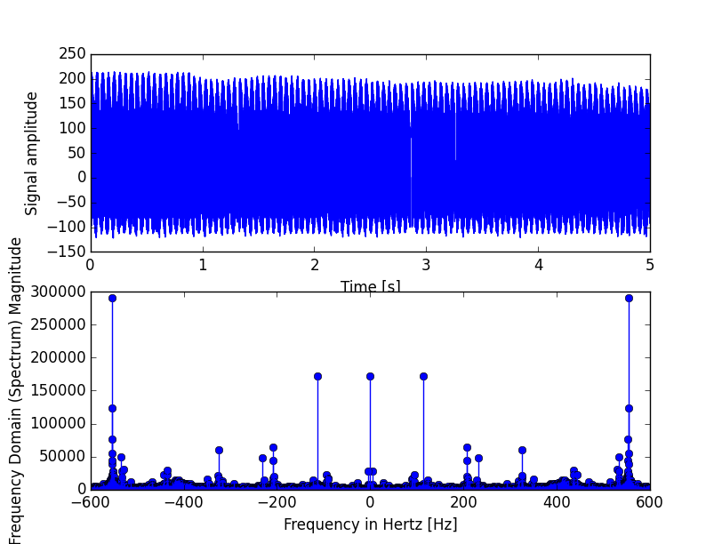
Closing Remarks
Using AutoCad to create housing for the design
Optimize and develop code to better analyze and record data using less CPU
Take advantage of the RPI’s wi-fi/bluetooth for IoT capabilities
550Hz with filter

